Slide 1

Data Story Project: TMDB Movie Dataset
John Brannigan & Caleb Cedeno - ITEC 4210 Data Story Project - Spring Semester 2025

Slide 2
Contents
00
01
02
03
04
05
Project Purpose
Dataset Summary
Dataset Manipulation
Analysis
Visualizations
Conclusion
John Brannigan & Caleb Cedeno - ITEC 4210 Data Story Project - Spring Semester 2025

Slide 3
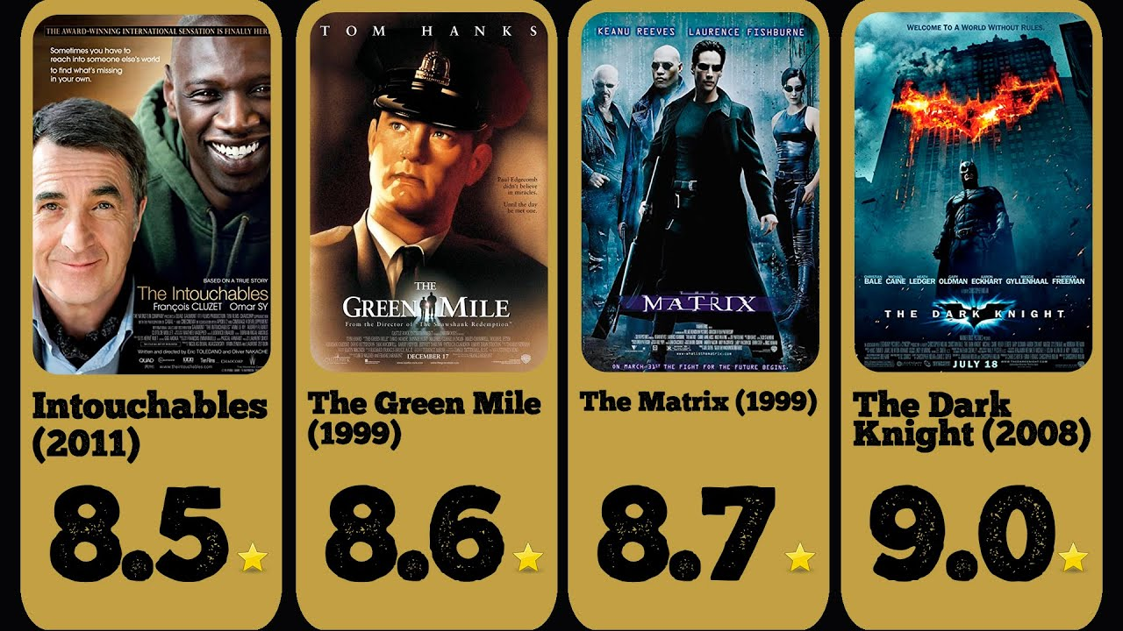
Purpose
Purpose of the following presentation
Explore and analyze profits in the film industry based on genre, production company, and production country.
Aim to give a hypothetical film director insights into profit trends to highlight which companies and countries would be better to pursue.
John Brannigan & Caleb Cedeno - ITEC 4210 Data Story Project - Spring Semester 2025

Slide 4



Dataset Summary
Comprehensive Film Database
Breakdown of Financial Data
Ample Nominal Data
As of TMDB’s most recent update, there are over 1.1 million films in their database.
In the dataset, there are columns detailing the film’s budget, revenue, and (later computed) profit.
Data on the director, producers, genres, release date, production company/countries, cast, tagline, writers, composers, etc.
John Brannigan & Caleb Cedeno - ITEC 4210 Data Story Project - Spring Semester 2025

Slide 5
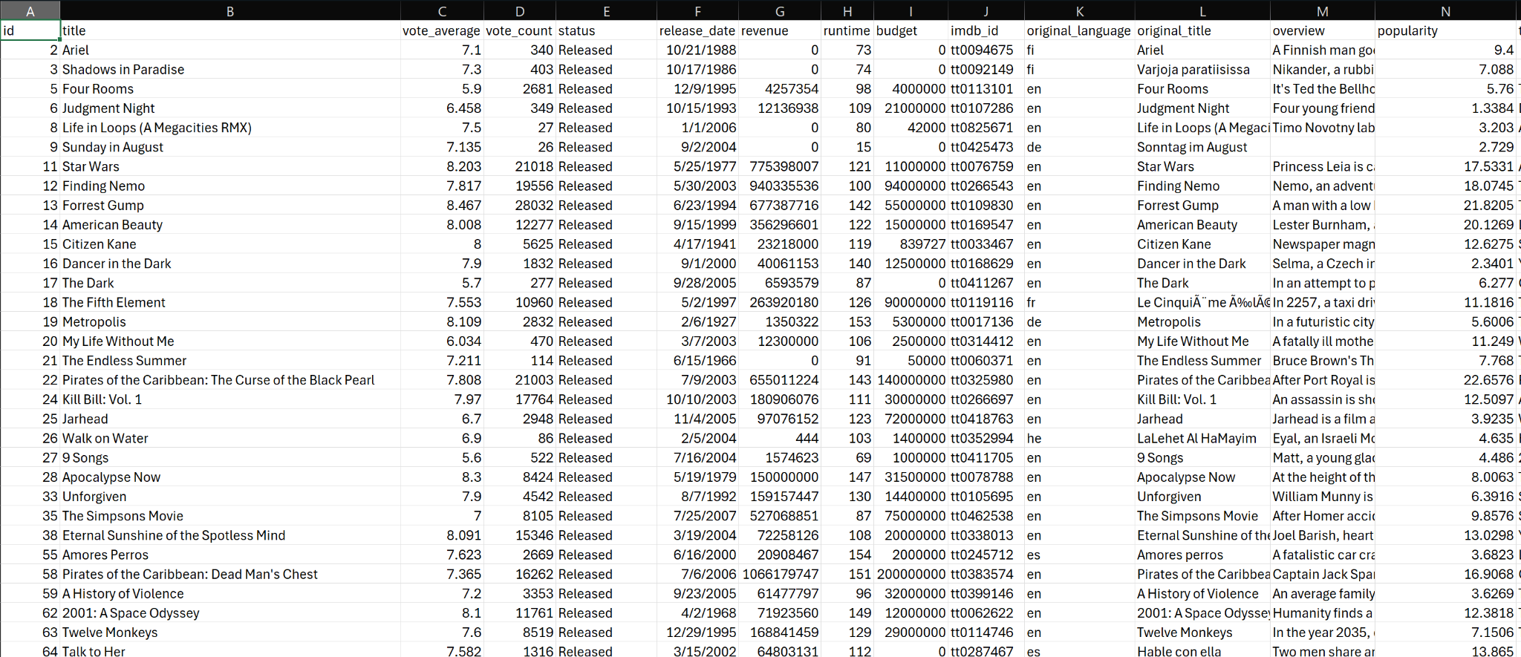

Dataset Overview
Offerings

Slide 6
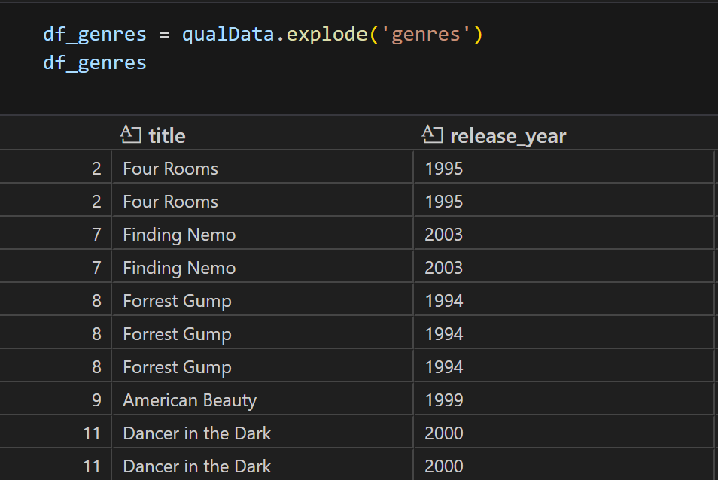
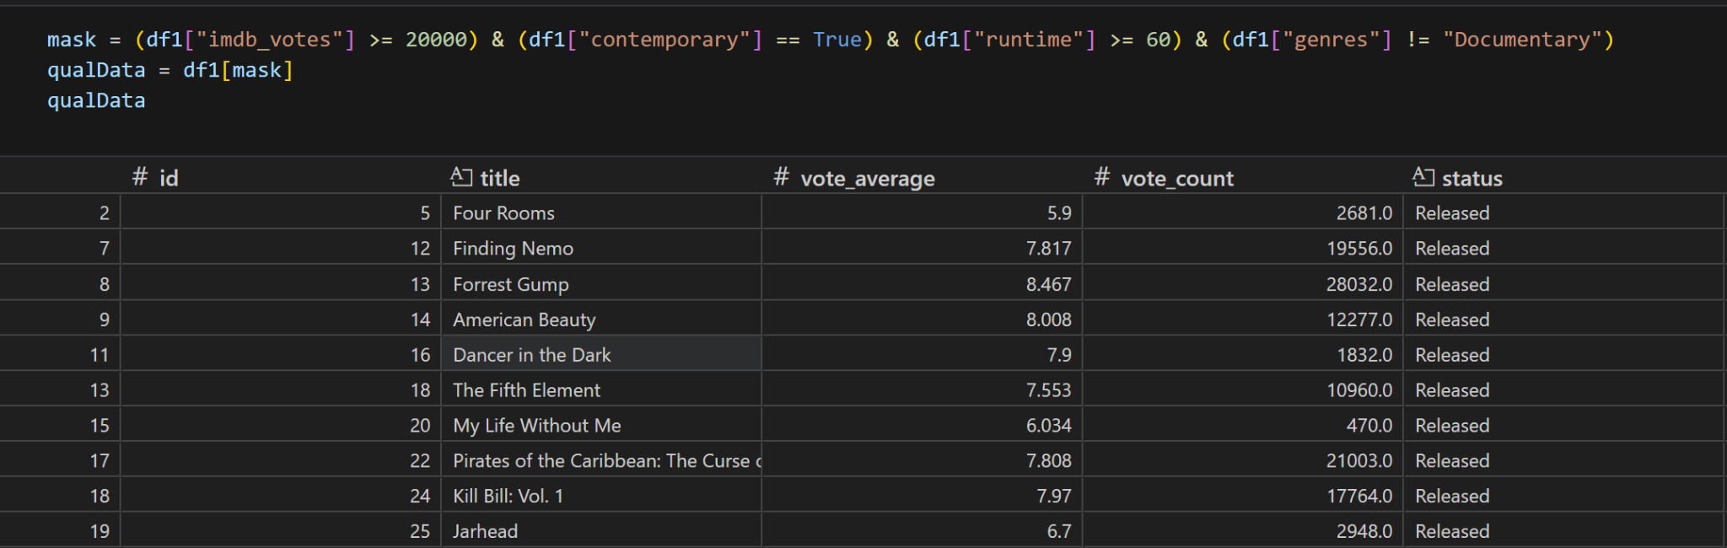
Dataset Manipulation & Analysis
With many unused columns, dropping them was a necessity to keep the dataset usable for this project.
Creating a mask to qualify the data based on a few metrics: number of votes, release date, runtime, and genre.
“Exploding” the dataset based on genre (then production) in order to count secondary and tertiary genres.
John Brannigan & Caleb Cedeno - ITEC 4210 Data Story Project - Spring Semester 2025
Notes:
Got to exploding by putting the genres column into its own variable, turning them all into lists, returning the first 3 genres per movie, and sending the list back into the dataframe, dropping films whose genres were null.
Exploding:
Finding Nemo is Animation and Family
Forrest Gump is Comedy, Drama, and Romance

Slide 7
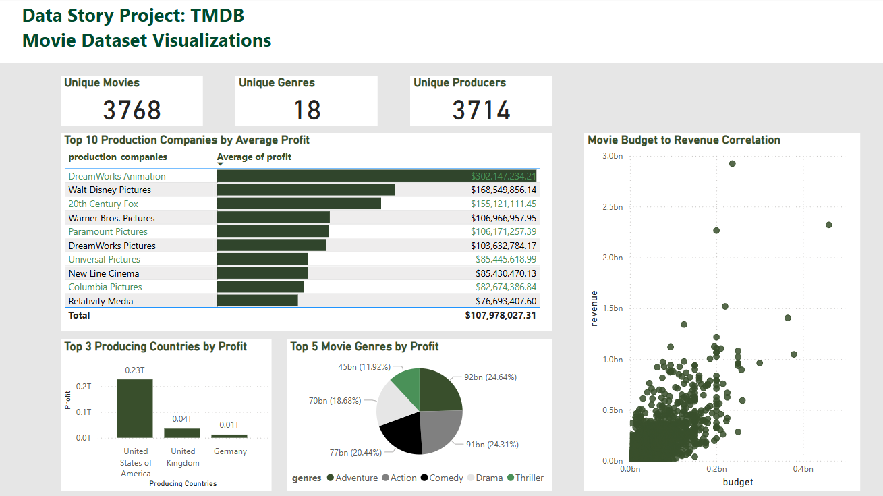
Visualizations
Seems to be a positive budget to revenue correlation
Renown production companies in top 10 most profitable on average
John Brannigan & Caleb Cedeno - ITEC 4210 Data Story Project - Spring Semester 2025

Slide 8
Conclusion
“
Make Complex Data more Understandable
Highlight Patterns, Outliers, Leaders
Support Strategic Decision Making
Scatter plot instantly reveals positive trend between movie budget and revenue of over 3,000 unique movies.
Dreamworks Animation stands out with over $302M average profit, and the pie chart highlights adventure and action as top earning genres.
Knowing the U.S. dominates in profit production could help focus investments toward the right market.
Provide data driven insights via data visualization
John Brannigan & Caleb Cedeno - ITEC 4210 Data Story Project - Spring Semester 2025

Slide 9

Thank You!
Open for Q&A
John Brannigan & Caleb Cedeno - ITEC 4210 Data Story Project - Spring Semester 2025

Slide 10
References
Vourc’h, A. (2025, April 20). The ultimate 1MILLION movies dataset (TMDB + imdb). Kaggle. https://www.kaggle.com/datasets/alanvourch/tmdb-movies-daily-updates
Colab Notebook: https://colab.research.google.com/drive/1iCuh51taDsy9K6OxMpTB47fCEcBaSyx-?usp=sharing
John Brannigan & Caleb Cedeno - ITEC 4210 Data Story Project - Spring Semester 2025

